Slide 1

Advanced Business Analytics
Presentation by Team 10
Amal T, Parth S, Pratik K, Supriya M, Tvisha G,
Vedanti G

Slide 2

Business Problem
SuperStore sells over 1800 products in 49 states (More than 500 cities) in the USA. Data is from 1/3/2014 to 12/30/2017
The company takes a more conventional approach to inventory management, basing forecasts on sales managers' experience and manually tracking each SKU's stock.
As a result, it faces supply chain problems with demand mapping and slow-moving/obsolete stock or stockouts
SuperStore is looking to take a more analytical approach to demand forecasting that will help improve its inventory management processes.

Slide 3
$47,858
16%
5.9%
Average monthly sales
Average Discount offered
Return Rate
$28
15.7%
6
Average Profits
Average Growth Sales YoY
Average orders/customer

Slide 4


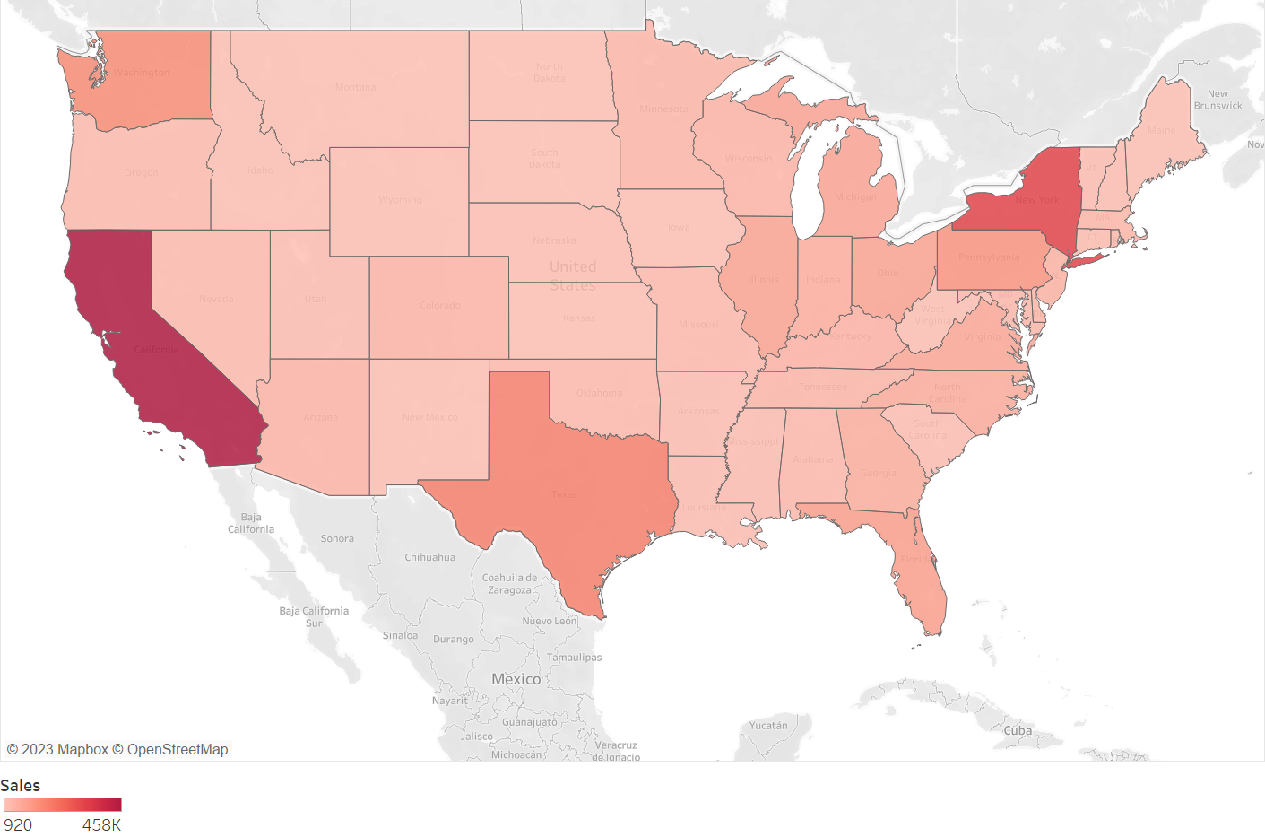

EDA – Top insights
Upcoming Deposits
Sales of 1850 products belonging to 17 sub-categories and 3 categories across 4 regions, 49 states and 531 cities
Avg time to ship: 4 days
Sales
$2.3M
5% of same day shipping orders are delayed
Profit
$286k
Discount
$567k
Key Facts
Delivery Time
Value of returned products
$180k
Heat map of sales by states
Avg Profitability is 12%
Subcategory is a significant variable
301 products are not profitable. On these products, $77k loss realized, and sales lost due to discounting is $244k
3 subcategories, which account for 16% sales, are loss making, with high discounts
Subcategory variable is the only significant variable for segmenting as per ANOVA
6 subcategories (30%) account for 81% of the profit
Profitability
Inferences

Slide 5










Methodology
Subcategory
Optimal Model
Train Split
Jan 2014 – Aug 2017
Holt Winter’s
MNM
Smartly manage
inventory
on the
basis of
quantities forecasted
Phone
Holt Winter’s
MAM
Paper
Monthly
Lead Time of One Month
Holt Winter’s
AAA
Chairs
Supermarket Data
Identify 6 most profitable sub-categories
Exploratory Analysis
ARIMA
(3,1,3),(0,1,0)
Accessories
Validation Split
Oct 2017 – Dec 2017
Monthly
Binders
ARIMA
(0,1,1),(0,1,0)
Compare Models on Interpretability and MAPE Score
No Model
Copiers
Quarterly

Slide 6
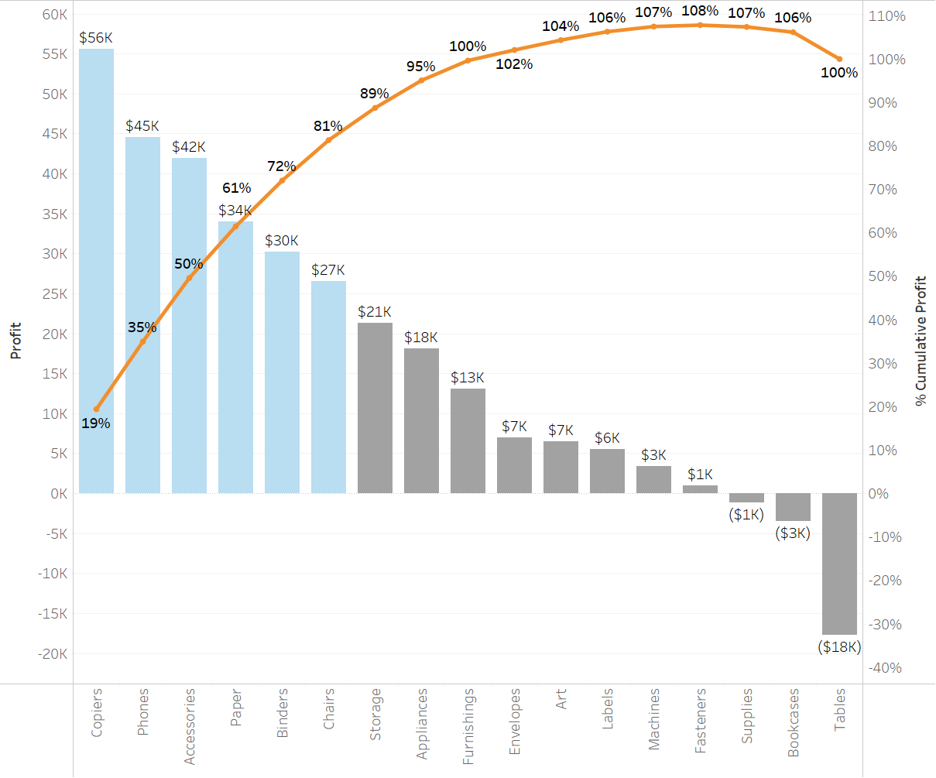
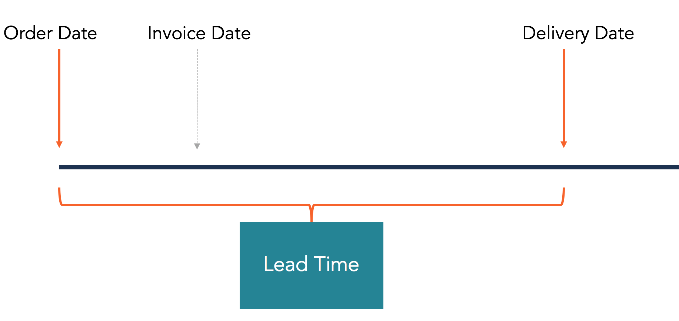
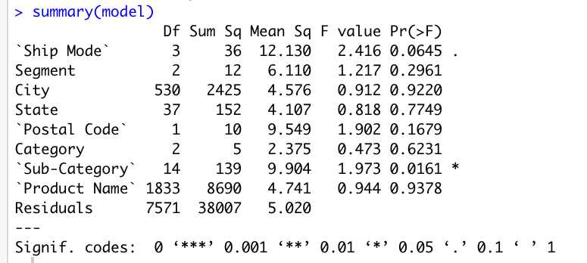
KEY HIGHLIGHTS IN APPROACH
Gap between training and validation data
Statistically, sub-category is a significant variable
In a practical setting, there should exist a gap between training and validation dataset on account of lead time
Top 6 sub-categories (35%) account for 81% of all sales
MAPE used as an evaluation metric
These sub-categories are highly profitable and managing inventory for these is critical
Notes:
Talk about: Gap in train-test, segmenting products and conducting forecast for that particularly, MAPE,

Slide 7
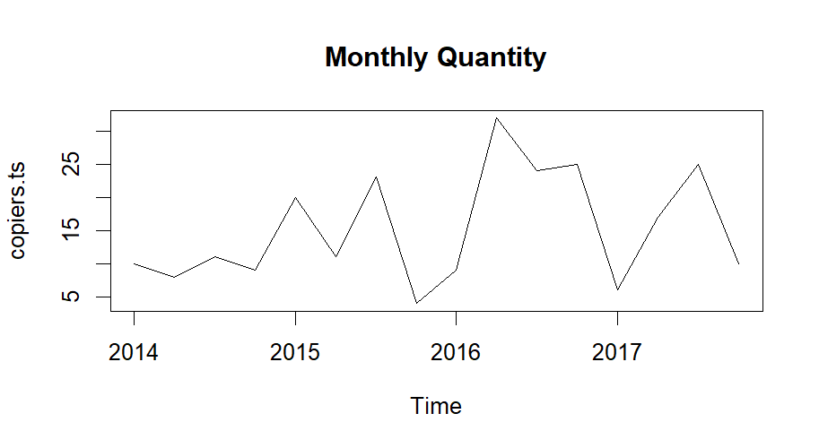
MODEL Approach: COPIERS
Copiers account for 19.4% of total profit
Timeseries Components
Noise, Level
Why no model?
Time Series is a random walk
Inventory Strategy
Maintain a stock of 30 copiers per quarter since demand cannot be forecasted and product is a high profit SKU with longer lead times
Quarterly Quantity

Slide 8
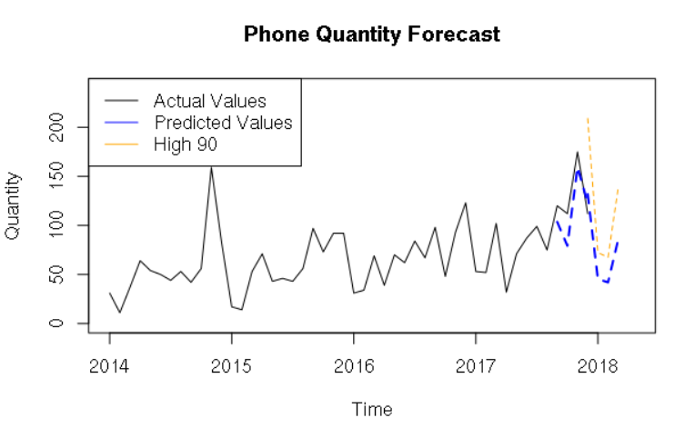

MODEL Approach: PhoneS
Phones account for 15.5% of total profit
Timeseries Components
Seasonality, Noise, Level
Why this model?
Optimal model, Lowest MAPE
Inventory Strategy
Maintain stocks as per forecast and not upper limit of confidence interval as product is at higher risk of obsolescence
Error metrics for best model: Validation MAPE: 20.1%
ARIMA
Holts Winters (MNM)
Linear Regression
Seasonal Naive
Moving Average
Holts Smoothing
Naive

Slide 9
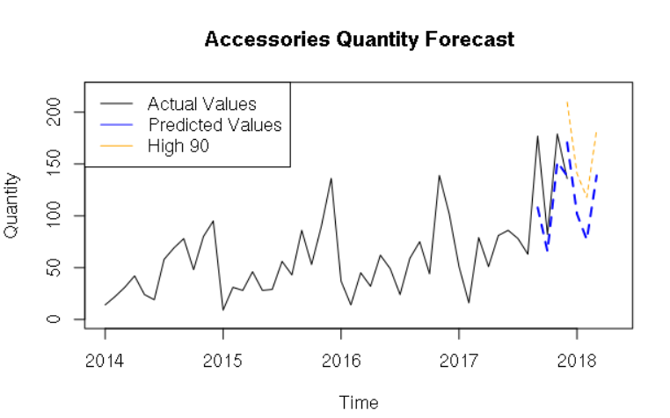
MODEL Approach: ACCESSORIES
Accessories account for 14.6% of total profit
Timeseries Components
Seasonality, Trend, Noise, Level
Why this model?
Optimal model, Lowest MAPE
Inventory Strategy
Maintain stocks as per upper limit of confidence interval as product is not at higher risk of obsolescence and highly profitable
Error metrics for best model: Validation MAPE: 14.1%
Holts Winters
ARIMA
Linear Regression
Holts Smoothing on deseasonalized series
Holts Smoothing
Moving Average
Seasonal Naive
Naive

Slide 10
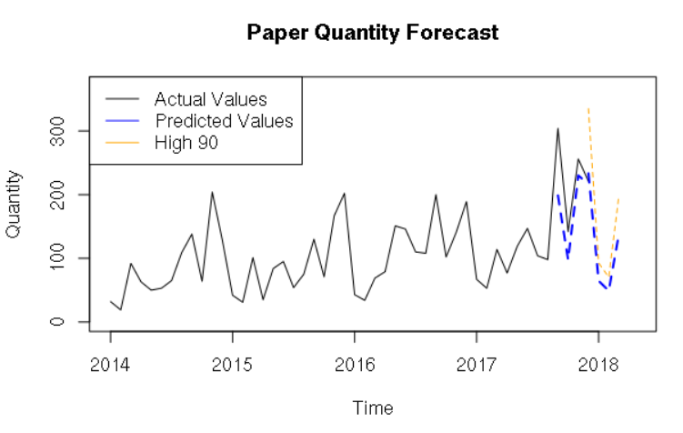
MODEL Approach: PAPER
Paper account for 11.9% of total profit
Timeseries Components
Seasonality, Trend, Noise, Level
Why this model?
Low MAPE and little difference between train and validation MAPE
Inventory Strategy
Maintain stocks as per upper limit of confidence interval as product is not at higher risk of obsolescence and highly profitable
Error metrics for best model: Validation MAPE: 19.7%
Holts Winters on detrended series
Holt Winters (MAM)
ARIMA
Linear Regression
Holts Smoothing
Moving Average
Seasonal Naive

Slide 11
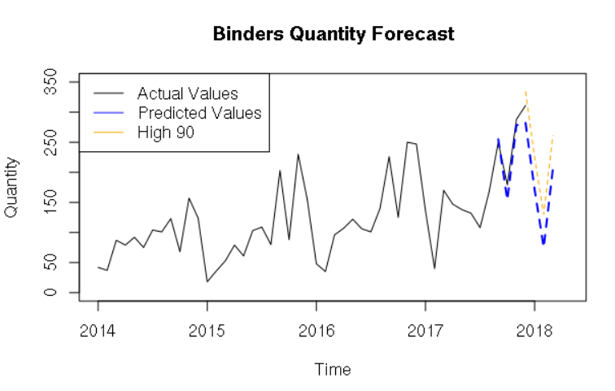
MODEL Approach: Binders
Binders account for 10.6% of total profit
Timeseries Components
Seasonality, Trend, Noise, Level
Why this model?
Optimal model
Inventory Strategy
Maintain stocks as per upper limit of confidence interval as product is not at higher risk of obsolescence
Error metrics for best model: Validation MAPE: 10.8%
Holt Winters
ARIMA
Linear Regression
Seasonal Naive
Moving Average
Holts Smoothing
Naive

Slide 12
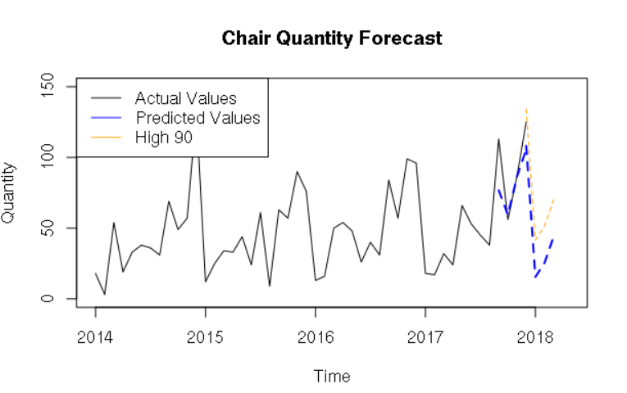
MODEL Approach: chairs
Chairs account for 9.3% of total profit
Timeseries Components
Seasonality, Trend, Noise, Level
Why this model?
Optimal model
Inventory Strategy
Maintain stocks as per upper limit of confidence interval as product is not at higher risk of obsolescence and highly profitable
Error metrics for best model: Validation MAPE: 8.1%
Holts Winters on deseason-alzied series
Holt Winters (AAA)
ARIMA
Linear Regression
Holts Smoothing
Moving Average
Seasonal Naive

Slide 13
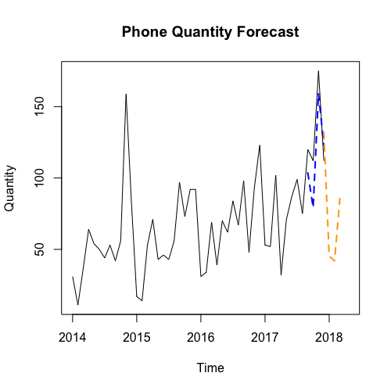
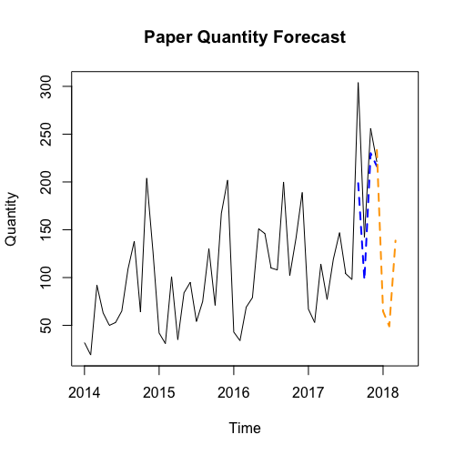
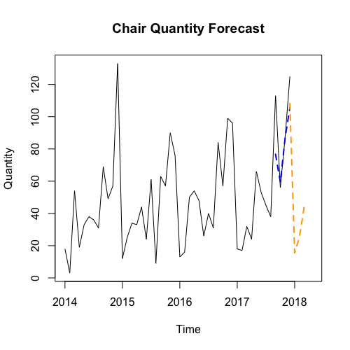
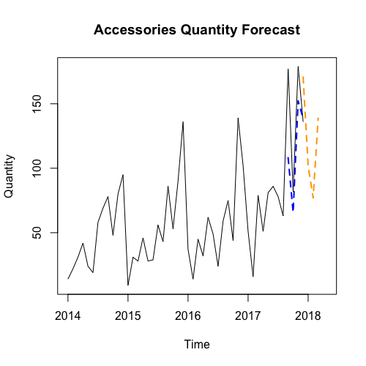
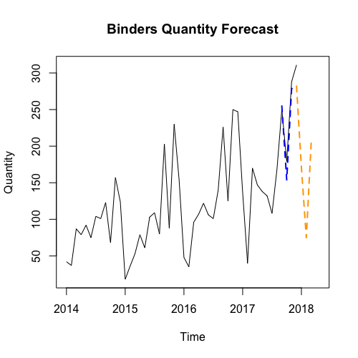
FORECASTING OVERVIEW
Subcategory
Best & Optimal Model
Forecasting Quantity after 1 Quarter Lead Time
MAPE: 20.06
MAPE: 19.66
MAPE: 8.10
Phone
Monthly
Holt Winter’s
ANN
Paper
Chairs
Supermarket Data
MAPE: 14.79
MAPE: 10.76
Accessories
Monthly
ARIMA
Binders
Quarterly
Copiers
Moving Average

Slide 14




Key TAKEAWAYS
Right Segment
Max Demand
Focused on top 6 categories thereby
accounting for 81% profits
Higher 95% forecast interval used as an insight
to meet for increased demand
Accuracy over Explainability
Business Rules for Random Walk
Right inventory management necessitates high forecast accuracy
Simple logic of maintaining at least 30 copiers per quarter to account for the randomness in sales

Slide 15



Learnings from the course
1.
3.
Accurate and relevant historical data is necessary to create reliable forecast for the future
Forecasting models are not perfect, it can have inaccuracies and cannot be blindly relied upon
2.
4.
High interpretability can take precedence over high accuracy based on business problem
Model outcomes should make intuitive business sense

Slide 16
THANK YOU

